Slide 1


Deep Links in Microsoft Teams (Extended lab)

Slide 2
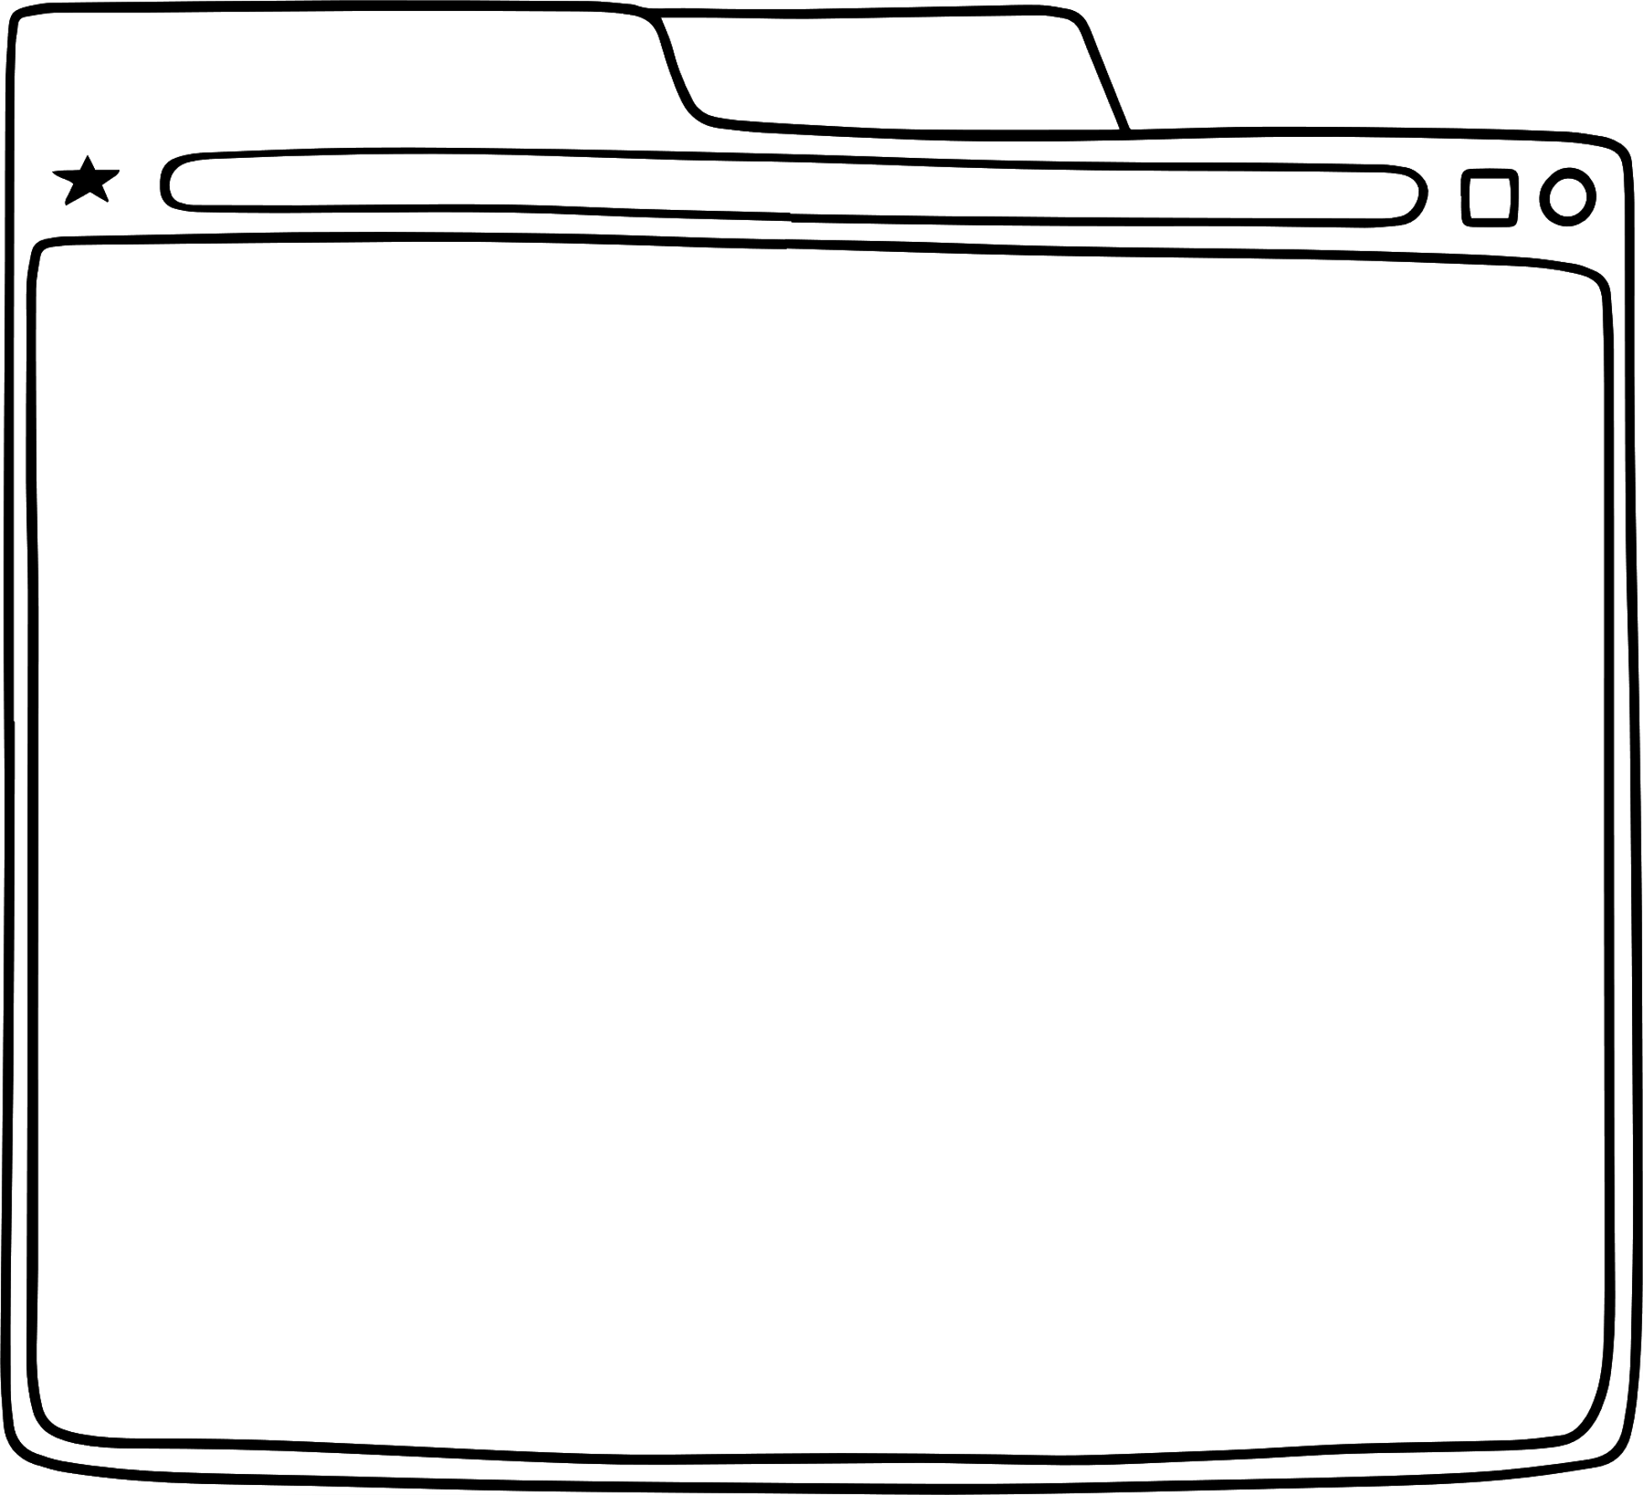




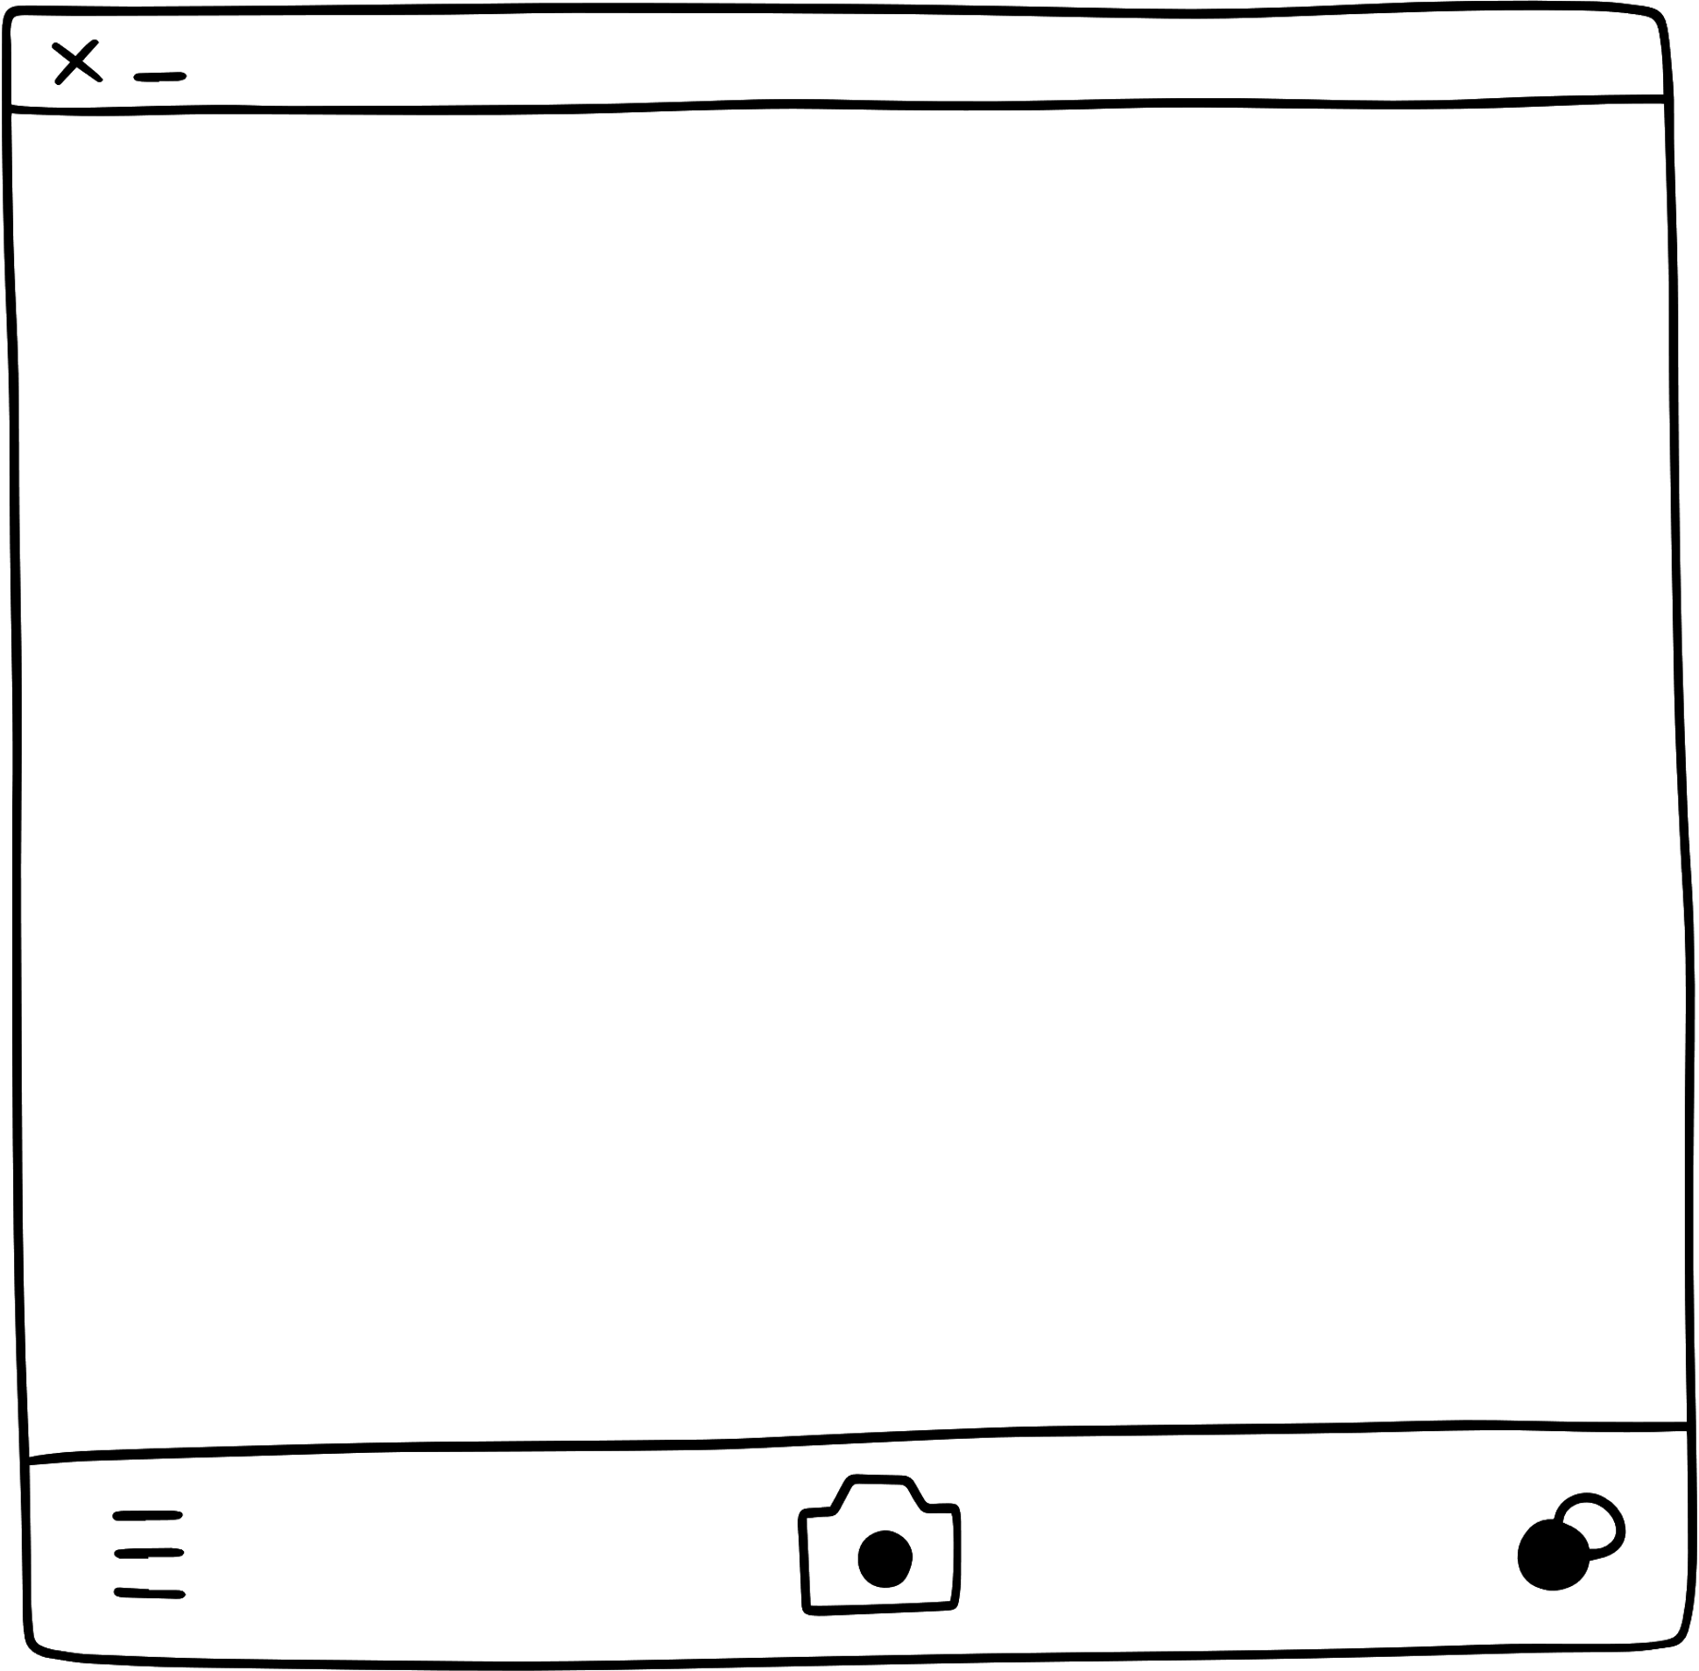


Deeplinks
Sends users to specific content within your app in Teams
Notes:
What are deep links in Teams? Any link that sends users to specific content within your app in Teams is a deep link. It's a single link that leads from anywhere into Teams, and into a specific channel or chat, and into a specific tab, and then to show specific information within in your app, all with one click. This saves users having to search or navigate for information every time they enter your application and making it so easy is a great way to drive application usage.

Slide 3
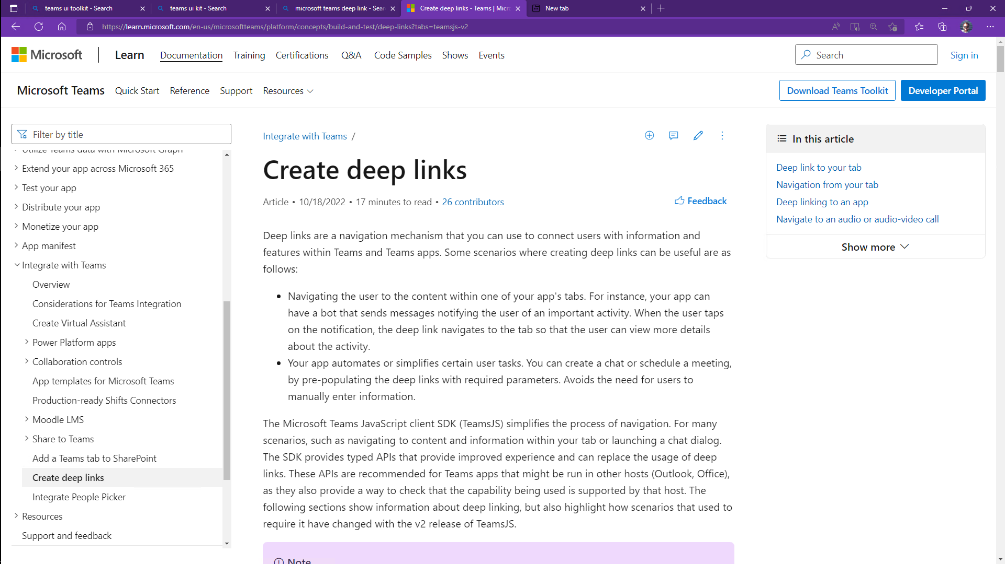
Deep Linking
Your app can create links to itself in context within Teams
Use these in notifications and messages in and outside of Teams
Send notifications that bring users back into your app
User Engagement
Connect users to work streams within your app along with related collaboration
Discoverability
Users bring colleagues into the app via simple links
External apps and pages can link into your app
Users are prompted to install the app if needed
Notes:
Suggested demo: Show the completed solution for the Deep Linking lab. Copy the deep link; close Teams and open the link to go all the way into an order within the app

Slide 4
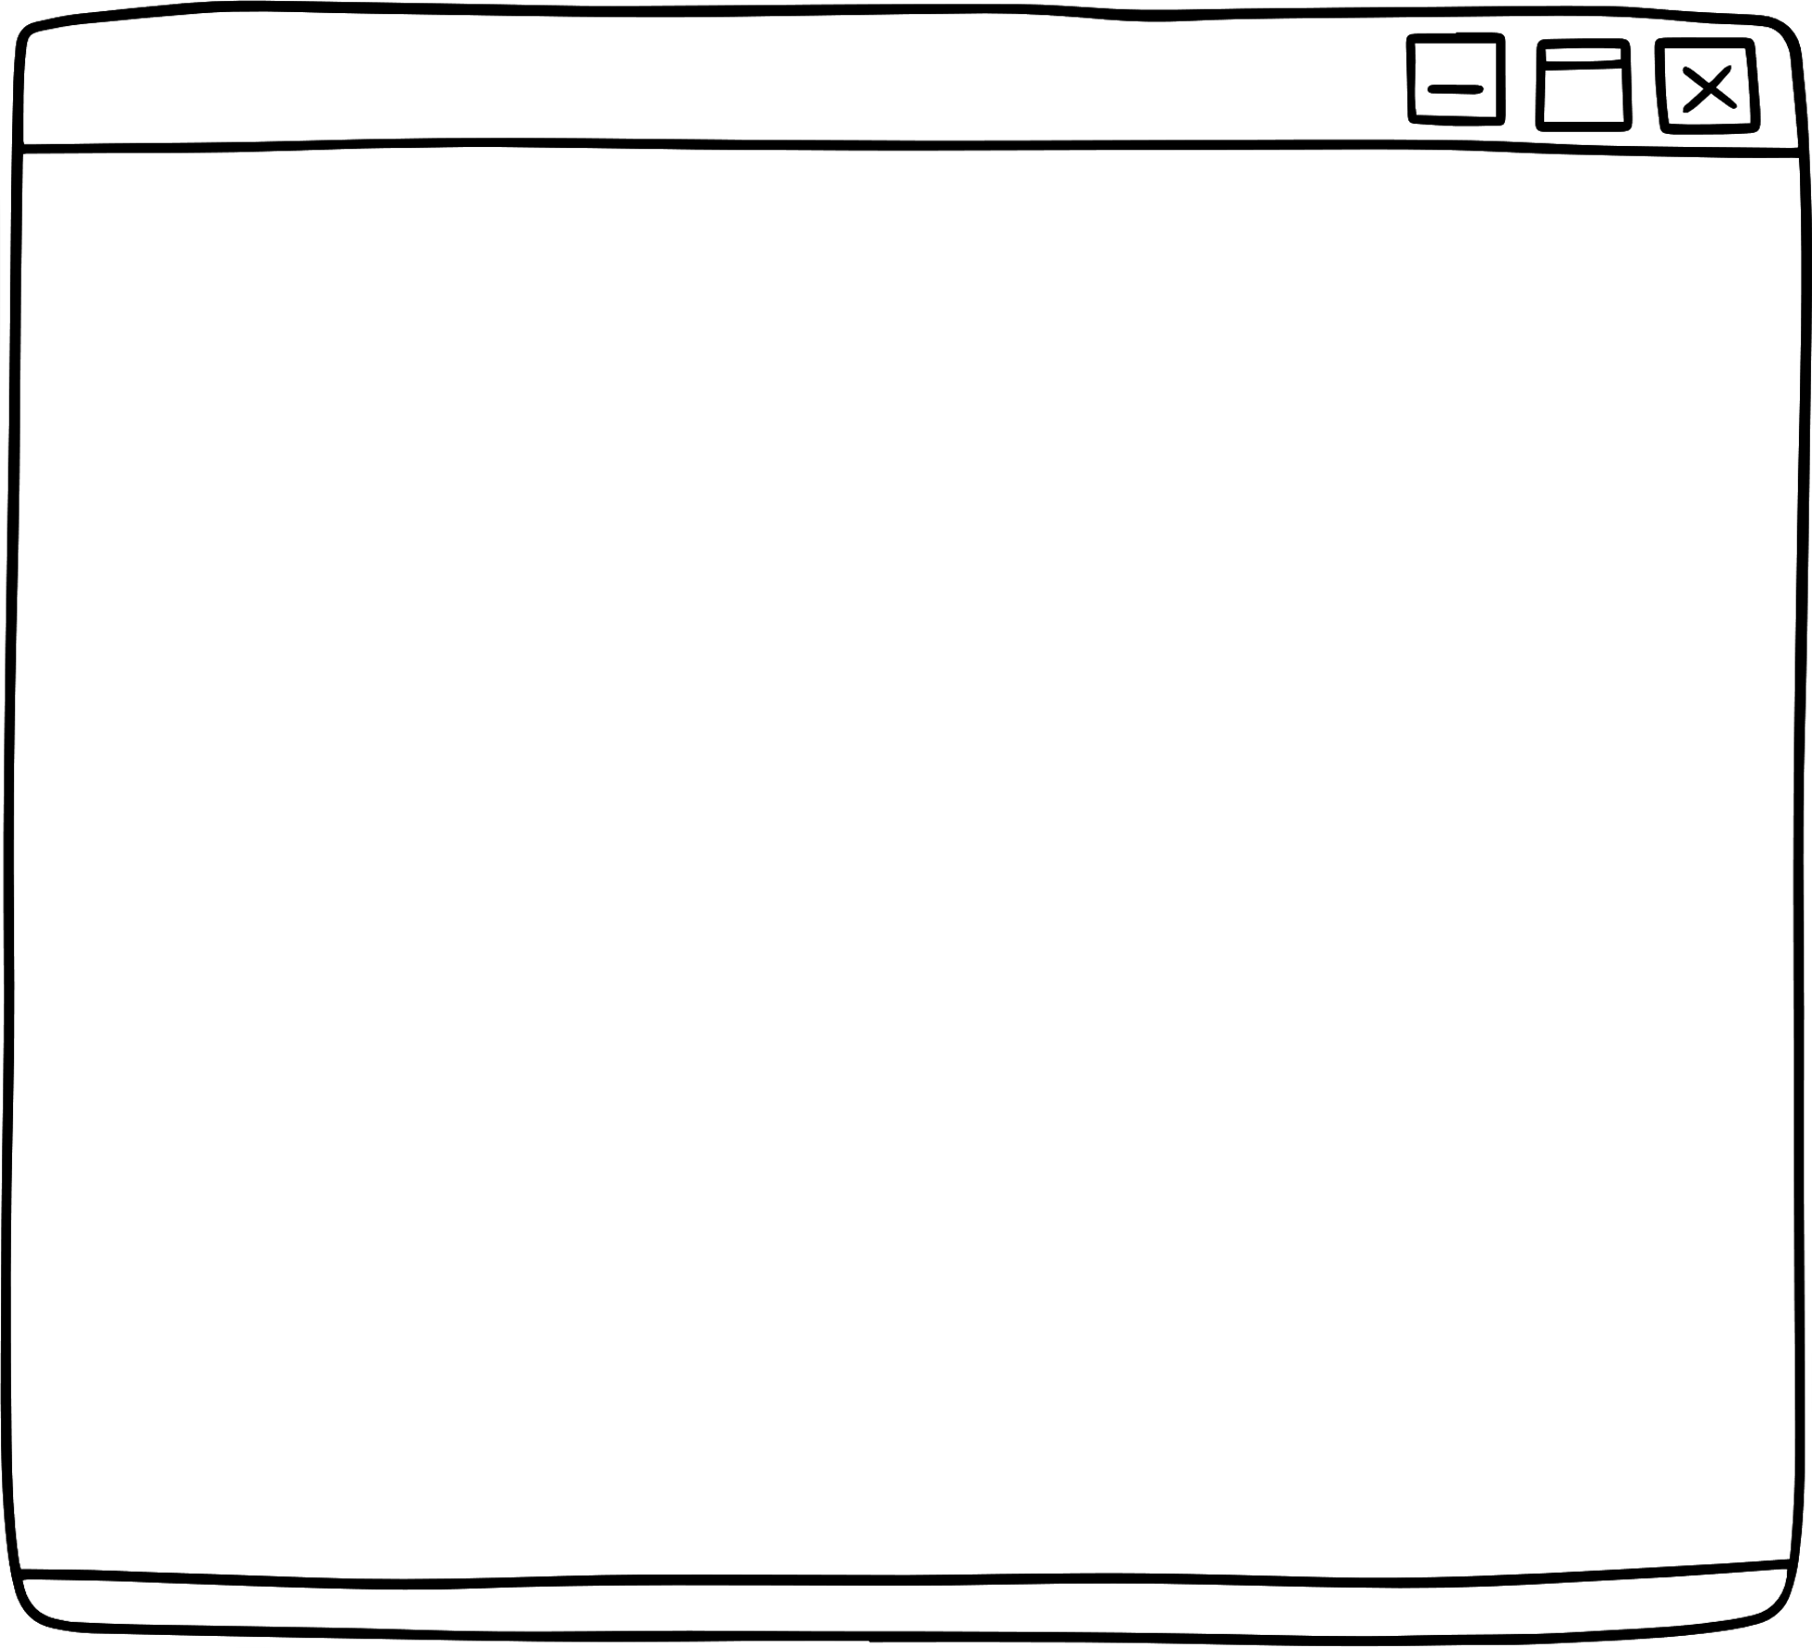


Link to a tab, channel conversation or file in channel
Link to a tab, channel conversation or file in channel
Open a chat
Open a meeting scheduling dialog
Invoke an audio/video call
Open an app install dialog
Notes:
Things you can do:
Create deeplink to a tab, channel conversation or file in channel
Open a meeting scheduling dialog
Open an app install dialog
Open a chat
Invoke an audio/video call

Slide 5

app-id
entityId
subEntityId
https://teams.microsoft.com/l/entity/<app-id>/<entitiyId>?context={"subEntityId": "<subEntityId>"}
Notes:
we have app-id - This teams app id from the manifest file
entityId - This is defined in your manifest file in the staticTabs object for the particular entity (tab). In our case this is Orders of My Orders tab.
subEntityId - This is the ID for the item you are displaying information for. This is similar to query parameters. In our case in this lab, it will be the orderId.
And combine these three to form the deep link to a specific order in the Northwind orders app.

Slide 6
https://teams.microsoft.com/l/entity/<app-id>/<entitiyId>?context={"subEntityId": "<subEntityId>"}

Slide 7

demo
Notes:
Lab demonstration:
- Run the completed deep link lab. Paste the deep link into a new browser session and shows how it launches Teams, AND the app, AND the correct order
- Show the file /client/pages/orderDetail.js; point out the deep link creation code in the copyUrlElement event listener. Note there is an API for this in the v2 SDK but at the time of this writing there was a warning that it didn’t work in all clients.
- Show the file /client/pages/myOrders.js. {point out the check for deep links that looks at the page context and redirects users to the correct order if needed

Slide 8
LAB TIME https://aka.ms/app-camp Add a Deep link to a personal Tab
Notes:
Note there is a video for each lab showing a complete walk-through

Slide 9

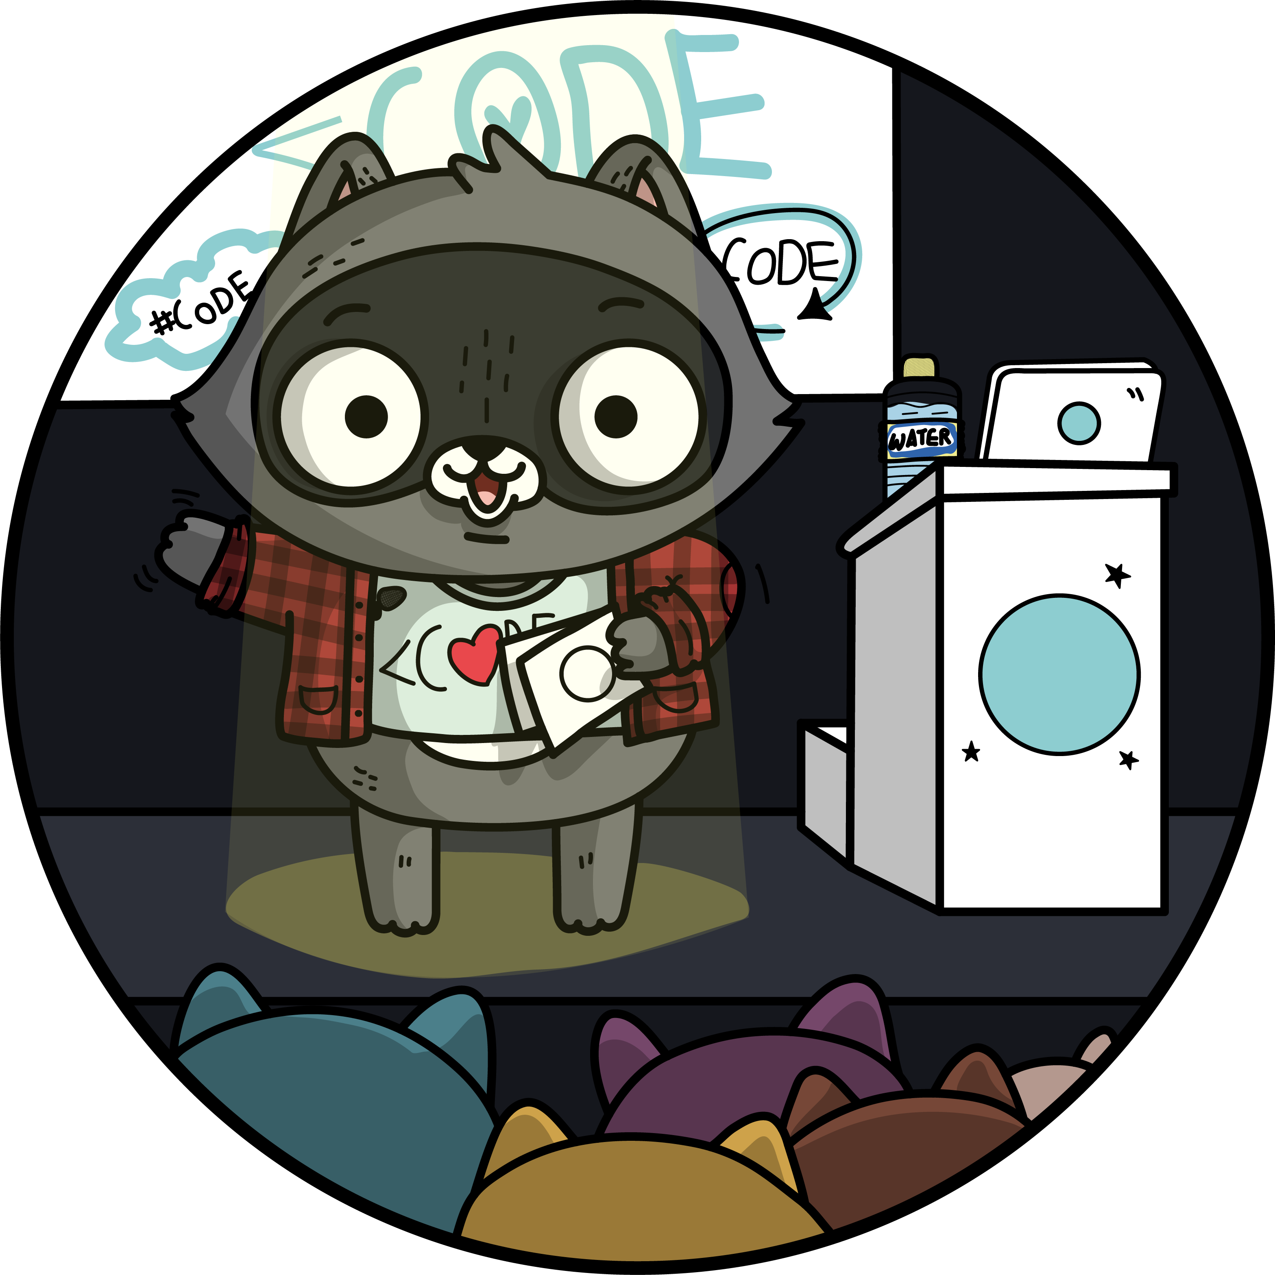

Lab Structure
Core Lab (path A)
App setup
Add tab with SSO
Add look and feel
Migrate an Azure AD Web App to Teams
start
Personal tab with
Azure AD SSO
Core Teams Application
Configurable
tab
Deeplinks
Dialog
Meeting App
Message Extension w/Adaptive Cards
Extend capabilities
Notes:
ASK ONE OF THE PARTICIPANTS TO DEMO THE APP

